Slide 1


DCTCP vs. Swift: Congestion Control in Data Centers
Data centers require low latency & high throughput.
Traditional TCP struggles in shallow-buffer environments.
Goal: Improve performance with smarter congestion control.
Different approaches: ECN & delay-based protocols.
Computer Networks 236340 – Winter 2024/25
Yasmin Mitkal , Omar Garah, Amir Watted
Advisor: Eran Tavor

Slide 2

Motivation
DCTCP vs. Swift: Congestion Control in Data Centers
Data centers require low latency & high throughput.
Traditional TCP struggles in shallow-buffer environments.
Goal: Improve performance with smarter congestion control.
Different approaches: ECN & delay-based protocols.
No RFC standard for Swift.
Computer Networks 236340 – Winter 2024/25
Yasmin Mitkal , Omar Garah, Amir Watted
Advisor: Eran Tavor

Slide 3

Project Goals
Steps Toward the Goal/Project Breakdown
Motivation
Understand the core principles of DCTCP and Swift.
Ramp up and configure the NS-3 simulator.
Build a fat-tree topology in NS-3.
Analyze the existing implementation of DCTCP in NS-3.
Implement the Swift protocol within NS-3.
Design and run simulations under varying load levels and traffic patterns.
Compare DCTCP and Swift performance
across different scenarios.
Design and implement a comprehensive comparative performance analysis between SWIFT and DCTCP.
Data centers require low latency & high throughput.
Traditional TCP struggles in shallow-buffer environments.
Goal: Improve performance with smarter congestion control.
Different approaches: ECN & delay-based protocols.

Slide 4




Steps Toward the Goal/Project Breakdown
Project Goals
Understand the core principles of DCTCP and Swift.
Ramp up and configure the NS-3 simulator.
Build a fat-tree topology in NS-3.
Analyze the existing implementation of DCTCP in NS-3.
Implement the Swift protocol within NS-3.
Design and run simulations under varying load levels and traffic patterns.
Compare DCTCP and Swift performance across different scenarios.
Design and implement a comprehensive comparative performance analysis between SWIFT and DCTCP.
ECN marking at threshold K.
Multi-bit feedback from ECN by tracking fraction of marked packets (α)->represents the extent of congestion.
Window adjustment proportional to extent of congestion.
Retains TCP behaviors
(slow start, additive increase, loss recovery).
ECN Mark (1bit)
Sender 1
Sender 2
Receiver

Slide 5

Theoretical Background

Slide 6
DCTCP Overview
DCTCP Algorithm
Sender 1
Sender 2
Switches mark incoming packets with CE when queue occupancy exceeds parameter K.
The Receiver Sets the ECN-Echo flag in ACKs to notify the sender of congestion until the sender acknowledges with a CWR flag.
The receiver aims to reflect the exact pattern of marked packets, enabling accurate estimation of congestion at the sender.
The sender computes α (fraction of marked packets) and adjusts the cwnd proportionally:
Larger α → more aggressive window reduction
Smaller α → gentler adjustment
ECN marking at threshold K.
Multi-bit feedback from ECN by tracking fraction of marked packets (α)->represents the extent of congestion.
Window adjustment proportional to extent of congestion.
Retains TCP behaviors
(slow start, additive increase, loss recovery).
α (1-g) x α + g x F
ECN Mark (1bit)
cwnd cwnd x (1- α / 2)
Receiver

Slide 7
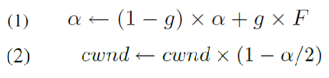
DCTCP Algorithm
Swift Overview
DCTCP Overview
Switches mark incoming packets with CE when queue occupancy exceeds parameter K.
The Receiver Sets the ECN-Echo flag in ACKs to notify the sender of congestion until the sender acknowledges with a CWR flag.
The sender computes α (fraction of marked packets) and adjusts the cwnd proportionally:
Larger α → more aggressive window reduction
Smaller α → gentler adjustment
ECN marking at threshold K.
Multi-bit feedback from ECN by tracking fraction of marked packets (α)->represents the extent of congestion.
Window adjustment proportional to extent of congestion.
Retains TCP behaviors
(slow start, additive increase, loss recovery).
ECN Mark (1bit)
Sender 1
Sender 2
Receiver

Slide 8
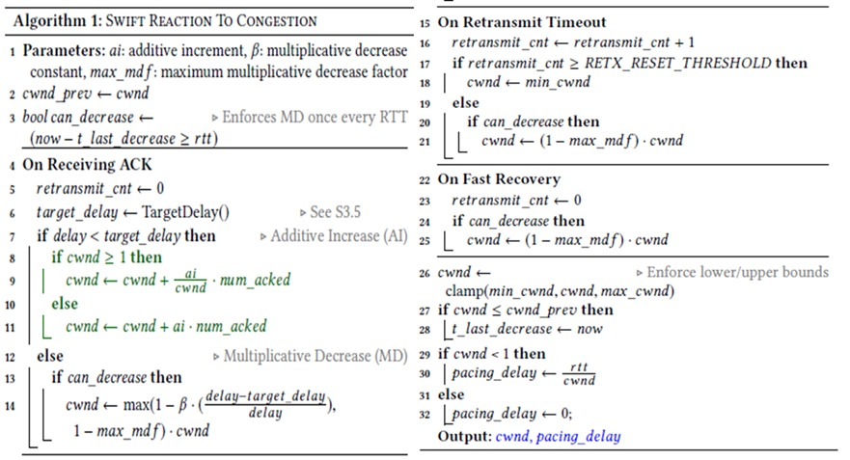

DCTCP Algorithm
Swift Overview
Switches mark incoming packets with CE when queue occupancy exceeds parameter K.
The Receiver Sets the ECN-Echo flag in ACKs to notify the sender of congestion until the sender acknowledges with a CWR flag.
The receiver aims to reflect the exact pattern of marked packets, enabling accurate estimation of congestion at the sender.
The sender computes α (fraction of marked packets) and adjusts the cwnd proportionally:
Larger α → more aggressive window reduction
Smaller α → gentler adjustment
Swift Algorithm
Delay-based congestion control.
Uses delay (RTT) as the primary congestion signal instead of loss or ECN.
α (1-g) x α + g x F
cwnd cwnd x (1- α / 2)
Scales target delay dynamically based on:
Topology
Flow load
Employs a simple AIMD controller to maintain a target delay.
Delay is decomposed into fabric and endpoint.

Slide 9
DCTCP in NS-3
Swift Algorithm
DCTCP is implemented as an extension of standard TCP in NS-3.
Follows original paper’s logic, with key additions such as:
PktsAcked() override: updates α using ECN-marked ACKs.
Used RED queues with ECN.
Fine tuned K.
Insight: Tuning K impacts fairness.
Swift Overview
Delay-based congestion control.
Uses delay (RTT) as the primary congestion signal instead of loss or ECN.
Scales target delay dynamically based on:
Topology
Flow load
Employs a simple AIMD controller to maintain a target delay.
Delay is decomposed into fabric and endpoint.

Slide 10
BBR vs Swift
BBR tries to set cwnd to the product of the estimated maximum bandwidth and the minimum RTT (the pure propagation delay).
Swift, on the other hand, defines a target delay and then continuously adjusts the cwnd so that the actual RTT stays close to this target.

Slide 11
DCTCP in NS-3
Swift Algorithm
DCTCP is implemented as an extension of standard TCP in NS-3.
Follows original paper’s logic, with key additions such as:
PktsAcked() override: updates α using ECN-marked ACKs.
Used RED queues with ECN.
Fine tuned K.
Insight: Tuning K impacts fairness.

Slide 12
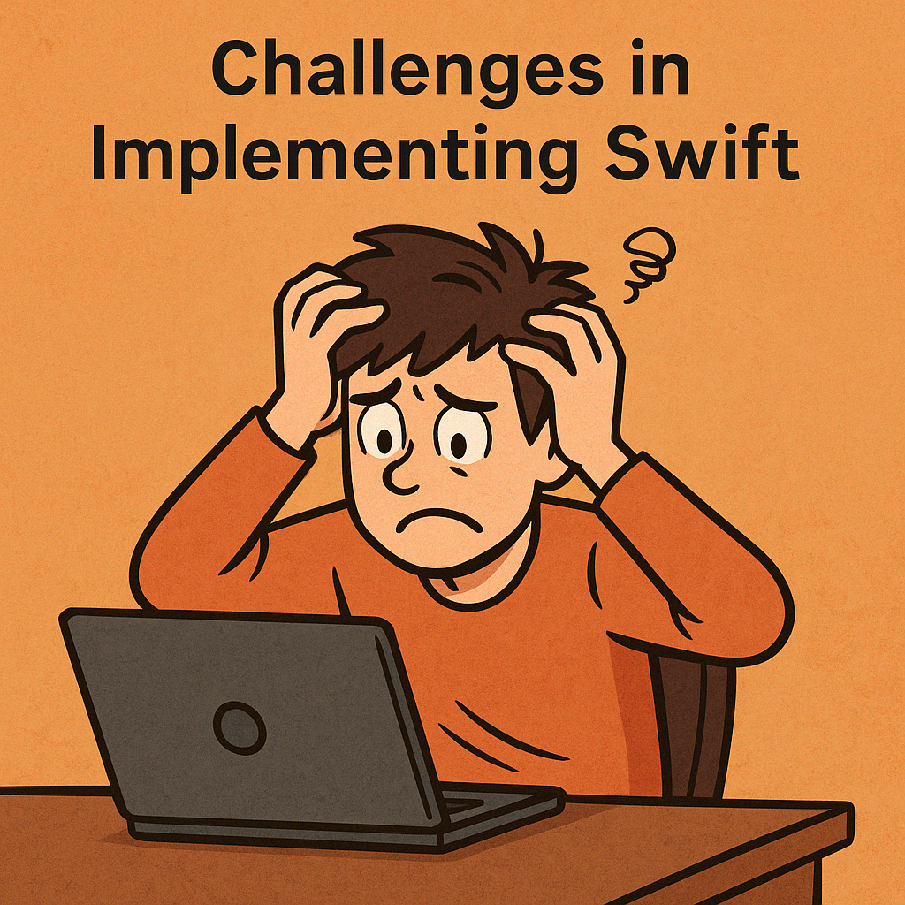
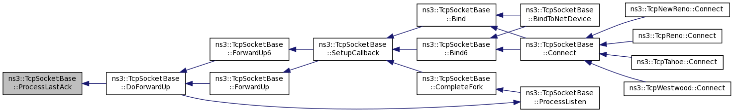
Challenges in Implementing Swift
Swift Algorithm
Not everything about Swift is clearly defined for example, how to handle the slow start phase was unclear.
We had to fully understand and dive into the entire TCP stack in NS-3 in order to integrate Swift correctly.

Slide 13
Implemented Swift as a subclass of TcpNewReno.
Added fields: alpha, beta, min_cwnd, max_cwnd.
Implemented a function that estimates Target delay.
Overrode key functions:
IncreaseWindow: compares measured delay vs. target delay
Retransmit
EnterRecovery
Used existing TcpSocketState fields:
RTT
PacingRate
Configuration Challenges & Fairness Considerations
DCTCP in NS-3
Swift in NS-3 (Implementation)
DCTCP is implemented as an extension of standard TCP in NS-3.
Follows original paper’s logic, with key additions such as:
PktsAcked() override: updates α using ECN-marked ACKs.
Used RED queues with ECN.
Fine tuned K.
Insight: Tuning K impacts fairness.
Target Delay Configuration
Parameter Tuning
Fair Comparison with DCTCP

Slide 14

Swift in NS-3 (Implementation)
Configuration Challenges & Fairness Considerations
Implemented Swift as a subclass of TcpNewReno.
Added fields: alpha, beta, min_cwnd, max_cwnd.
Overrode key functions:
IncreaseWindow: compares measured delay vs. target delay
Retransmit
EnterRecovery
Used existing TcpSocketState fields:
RTT
PacingRate
Target Delay Configuration
Parameter Tuning
Fair Comparison with DCTCP
Used static target delay or basertt.
Dynamic scaling left for future work due to paper ambiguity.
Many parameters had to be manually tuned.
Performance highly sensitive to their values.
Identical RED queues (no ECN for Swift).
Delay computation limited to fabric delay.
Matched buffer sizes and traffic load.

Slide 15
Configuration Challenges & Fairness Considerations
Target Delay Configuration
Parameter Tuning
Fair Comparison with DCTCP
Used static target delay or basertt.
Dynamic scaling left for future work due to paper ambiguity.

Slide 16
Configuration Challenges & Fairness Considerations
Parameter Tuning
Target Delay Configuration
Many parameters had to be manually tuned.
Performance highly sensitive to their values
Fair Comparison with DCTCP
Used static target delay or basertt.
Dynamic scaling left for future work due to paper ambiguity.
Many parameters had to be manually tuned.
Performance highly sensitive to their values.
Identical RED queues (no ECN for Swift).
Delay computation limited to fabric delay.
Matched buffer sizes and traffic load.

Slide 17
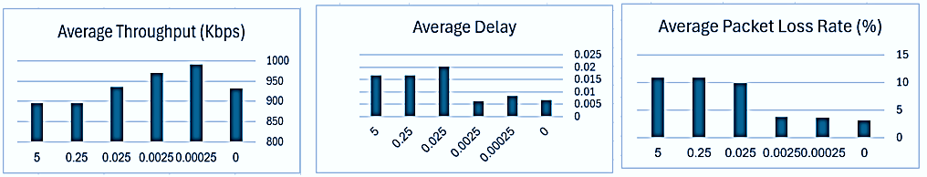
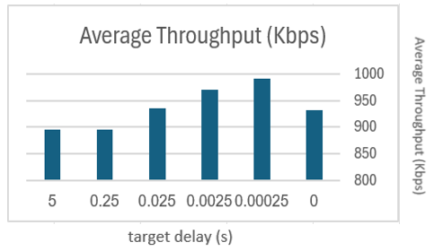
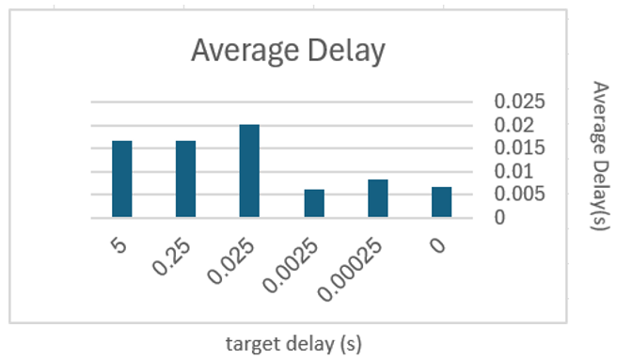
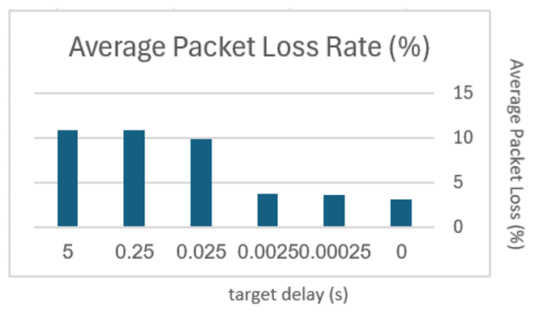
Configuration Challenges & Fairness Considerations
Average Throughput (kbps)
Average Delay
Average Packet Loss Rate(%)
Fair Comparison with DCTCP
Target Delay Configuration
Parameter Tuning
Identical RED queues (no ECN for Swift).
Delay computation limited to fabric delay.
Matched buffer sizes and traffic load.
Used static target delay or basertt.
Dynamic scaling left for future work due to paper ambiguity.
Many parameters had to be manually tuned.
Performance highly sensitive to their values.
Identical RED queues (no ECN for Swift).
Delay computation limited to fabric delay.
Matched buffer sizes and traffic load.

Slide 18
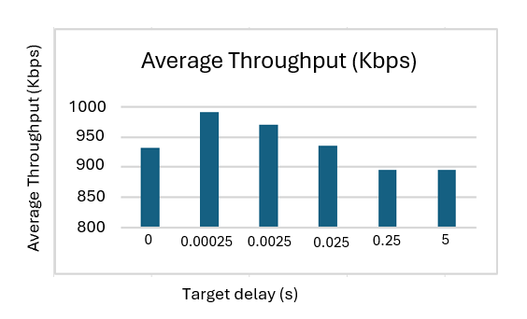
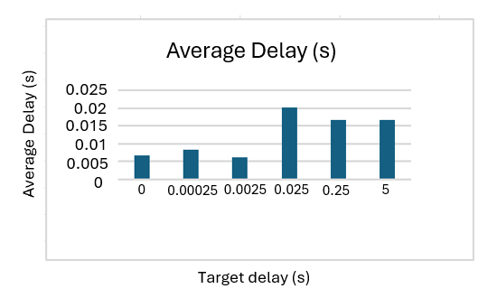
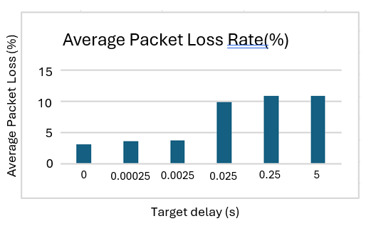
Configuration Challenges & Fairness Considerations
Target Delay Impact
Average Throughput (kbps)
Average Delay (s)
Average Packet Loss Rate(%)
Fair Comparison with DCTCP
Target Delay Configuration
Parameter Tuning
Identical RED queues (no ECN for Swift).
Delay computation limited to fabric delay.
Matched buffer sizes and traffic load.

Slide 19
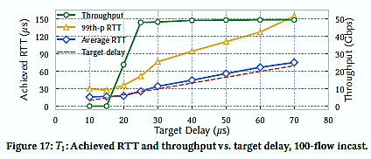
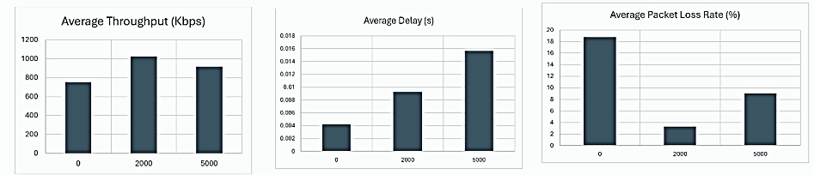
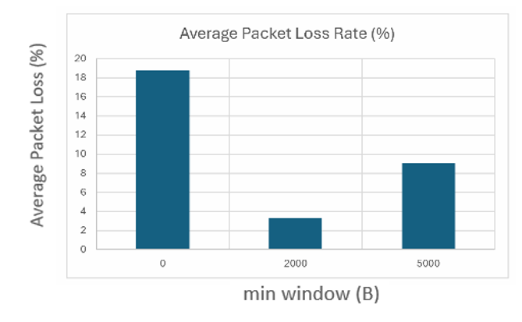
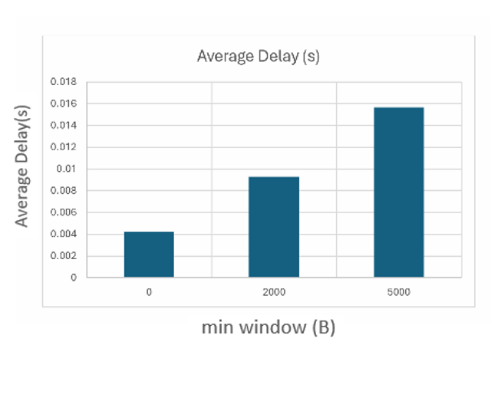
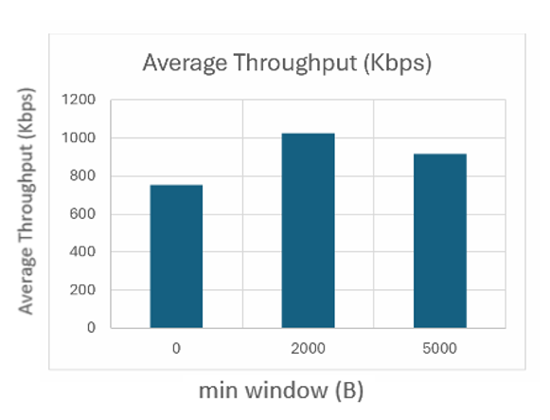
Best Strategy:
Using minimum observed RTT as the target delay.
Achieved best balance
Insights:
Confirms trade-off from Swift paper: larger delay boosts throughput; smaller delay reduces latency.
Our results show throughput peaks then drops as target delay increases (unlike paper).
min_cwnd Impact:
Too small → slow recovery after congestion.
Too large → high queuing, increased delay, and packet loss
Needs careful tuning to avoid over- or under-reacting.
Average Throughput (kbps)
Average Delay
Average Packet Loss Rate(%)

Slide 20
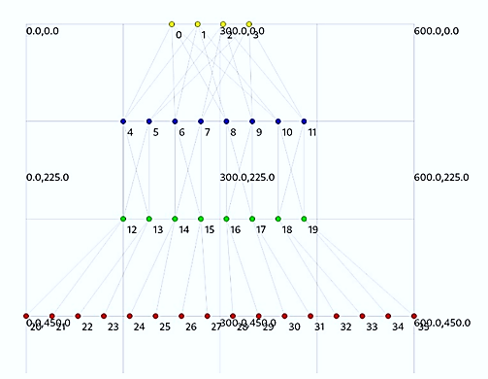
Best Strategy:
Using minimum observed RTT as the target delay.
Achieved best balance
Insights:
Confirms trade-off from Swift paper: larger delay boosts throughput; smaller delay reduces latency.
Our results show throughput peaks then drops as target delay increases (unlike paper).
min_cwnd Impact:
Too small → slow recovery after congestion.
Too large → high queuing, increased delay, and packet loss
Needs careful tuning to avoid over- or under-reacting.
Average Throughput (kbps)
Average Delay
Average Packet Loss Rate(%)
Simulation Setup
Fat-tree topology in NS-3.
Multiple traffic modes.
Metrics: Throughput, Delay, Packet Loss.
Averaged over 3 runs per data point.

Slide 21
Best Strategy:
Using minimum observed RTT as the target delay.
Achieved best balance
Insights:
Confirms trade-off from Swift paper: larger delay boosts throughput; smaller delay reduces latency.
Our results show throughput peaks then drops as target delay increases (unlike paper).
min_cwnd Impact:
Too small → slow recovery after congestion.
Too large → high queuing, increased delay, and packet loss
Needs careful tuning to avoid over- or under-reacting.
Average Throughput (kbps)
Average Delay
Average Packet Loss Rate(%)
Simulation Setup
Fat-tree topology in NS-3.
Multiple traffic modes.
Metrics: Throughput, Delay, Packet Loss.
Averaged over 3 runs per data point.

Slide 22
Best Strategy:
Using minimum observed RTT as the target delay.
Achieved best balance
Insights:
Confirms trade-off from Swift paper: larger delay boosts throughput; smaller delay reduces latency.
Our results show throughput peaks then drops as target delay increases (unlike paper).
min_cwnd Impact:
Too small → slow recovery after congestion.
Too large → high queuing, increased delay, and packet loss
Needs careful tuning to avoid over- or under-reacting.
Hypothesis: dropping packets locally before they ever reach the wire.
Average Throughput (kbps)
Average Delay
Average Packet Loss Rate(%)
Simulation Setup
Fat-tree topology in NS-3.
Multiple traffic modes.
Metrics: Throughput, Delay, Packet Loss.
Averaged over 3 runs per data point.

Slide 23

Simulation Setup
min_cwnd Impact:
Too small → slow recovery after congestion.
Too large → high queuing, increased delay, and packet loss
Needs careful tuning to avoid over- or under-reacting.
Average Throughput (kbps)
Average Delay
Average Packet Loss Rate(%)
Fat-tree topology in NS-3.
Multiple traffic modes.
Metrics: Throughput, Delay, Packet Loss.
On-off application
Averaged over 3 runs per data point.
3 swift variants:-
Static target delay – 25ms
Target delay is base rtt (min rtt observed)
Base rtt + $∈$ ~ 1ms
Fat-tree topology in NS-3.
Multiple traffic modes.
Metrics: Throughput, Delay, Packet Loss.
Averaged over 3 runs per data point.

Slide 24

Disclaimer: swift paper setup
min_cwnd Impact:
Too small → slow recovery after congestion.
Too large → high queuing, increased delay, and packet loss
Needs careful tuning to avoid over- or under-reacting.
Average Throughput (kbps)
Average Delay
Average Packet Loss Rate(%)
Swift paper compares against GCN a highly tuned version of DCTCP used by Google.
Traffic control setup in Google’s datacenters is unclear, while we used multiple traffic patterns: hotspot and random pairing.
Goal: Confirm qualitative trends, not exact performance.
Fat-tree topology in NS-3.
Multiple traffic modes.
Metrics: Throughput, Delay, Packet Loss.
Averaged over 3 runs per data point.

Slide 25
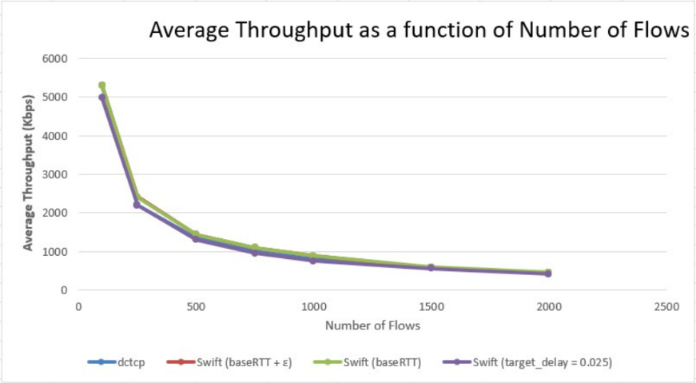
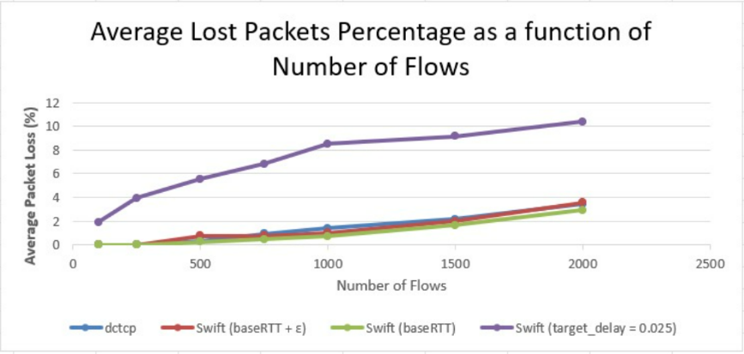
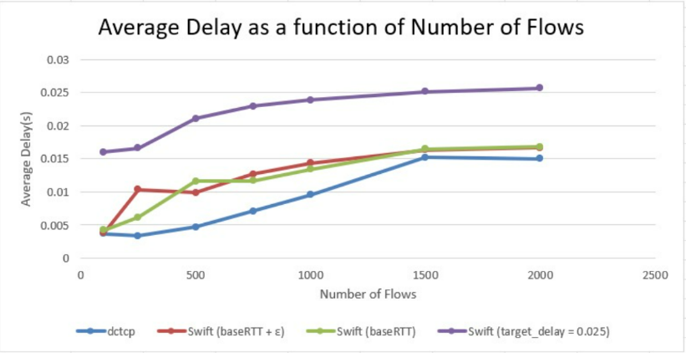
K=4 (16 hosts) and a 15 seconds simulation runtime mode 1 (random hot spot):

Slide 26
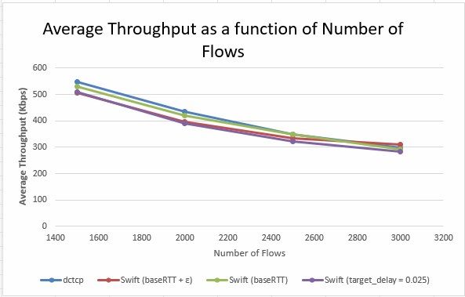
Zooming in on Throughput

Slide 27
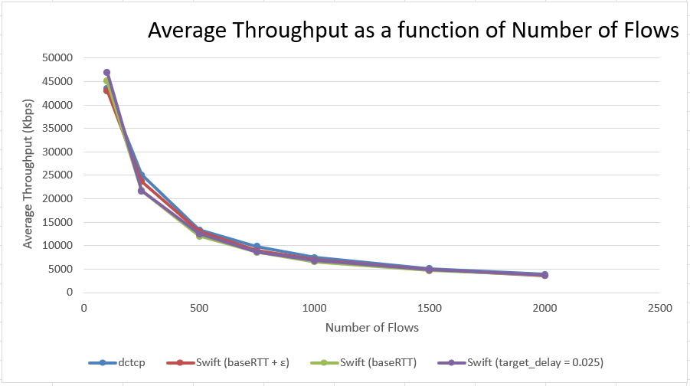
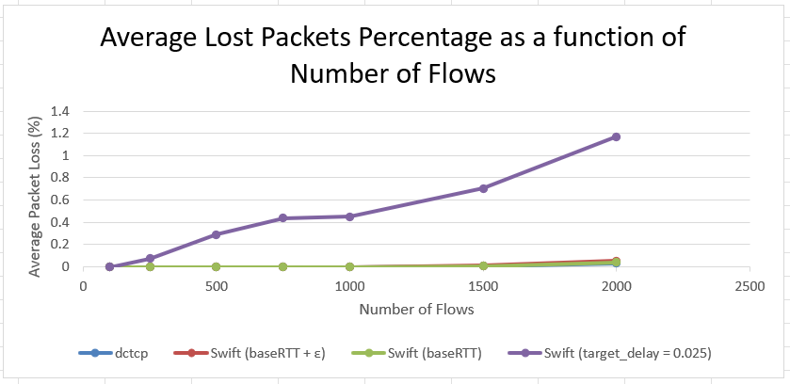
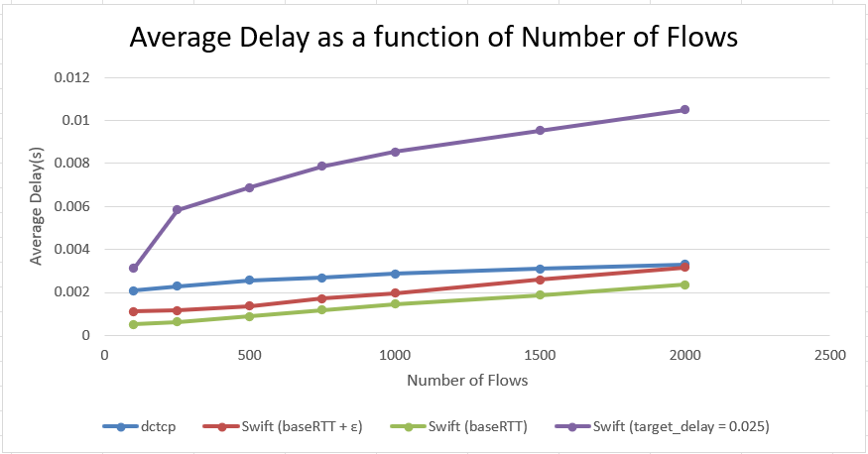
K=4 (16 hosts) and a 15 seconds simulation runtime mode 2 (random pairing):

Slide 28
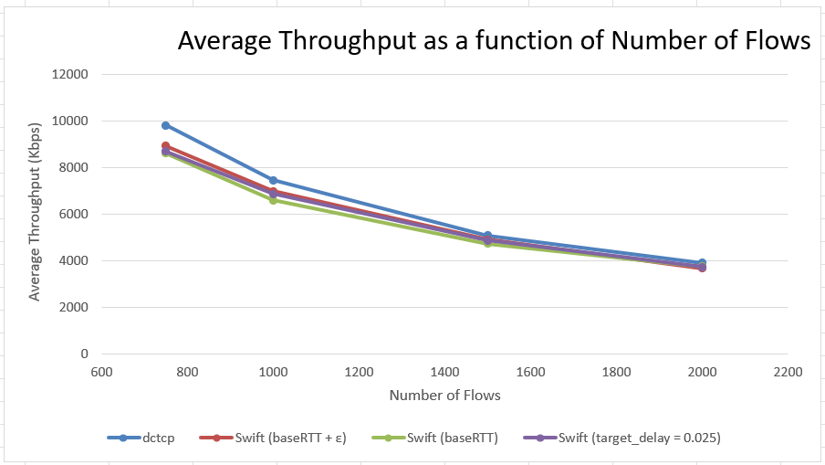
Zooming in on Throughput

Slide 29
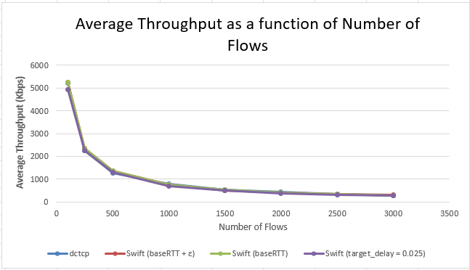
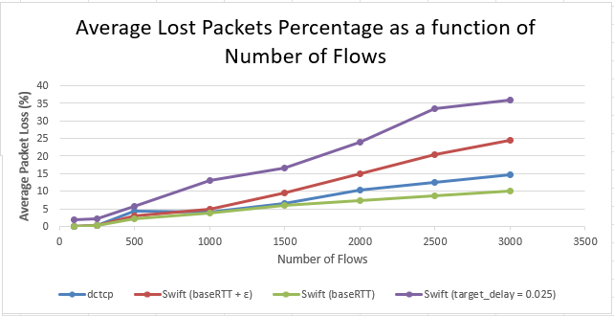
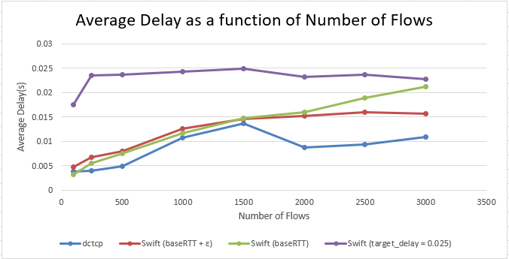
K=12 (432 hosts) and a 7 seconds simulation runtime mode 1 (random hot spot):

Slide 30
Zooming in on Throughput

Slide 31
Swift in NS-3 (Implementation)
Discussion of Results
Implemented Swift as a subclass of TcpNewReno.
Added fields: alpha, beta, min_cwnd, max_cwnd.
Overrode key functions:
IncreaseWindow: compares measured delay vs. target delay
Retransmit
EnterRecovery
Used existing TcpSocketState fields:
RTT
PacingRate
Throughput
Packet Loss
Delay
Used static target delay or basertt.
Dynamic scaling left for future work due to paper ambiguity.
Many parameters had to be manually tuned.
Performance highly sensitive to their values.
Identical RED queues (no ECN for Swift).
Delay computation limited to fabric delay.
Matched buffer sizes and traffic load.

Slide 32
Discussion of Results
Throughput
Swift (0.025 delay) had best throughput in low congestion. Under high congestion, it performed worst.
Small topologies: Swift (baseRTT) outperformed.
Large topologies: DCTCP slightly better.
Swift (baseRTT) and DCTCP are nearly equivalent in throughput under high congestion.
Packet Loss
Delay

Slide 33
Discussion of Results
Packet Loss
Throughput
Swift (0.025 delay) had highest loss.
Swift (baseRTT) had lowest loss.
Swift (baseRTT + ɛ) slightly worse than baseRTT but better than fixed delay.
baseRTT keeps window small, minimize queuing and packet loss.
Delay
Used static target delay or basertt.
Dynamic scaling left for future work due to paper ambiguity.
Many parameters had to be manually tuned.
Performance highly sensitive to their values.
Identical RED queues (no ECN for Swift).
Delay computation limited to fabric delay.
Matched buffer sizes and traffic load.

Slide 34
Discussion of Results
Average Throughput (kbps)
Average Delay
Average Packet Loss Rate(%)
Delay
Throughput
Packet Loss
Swift (baseRTT): Lowest delay in low/moderate congestion (mode 2).
In high congestion DCTCP showed lower delay than baseRTT.
Used static target delay or basertt.
Dynamic scaling left for future work due to paper ambiguity.
Many parameters had to be manually tuned.
Performance highly sensitive to their values.
Identical RED queues (no ECN for Swift).
Delay computation limited to fabric delay.
Matched buffer sizes and traffic load.

Slide 35
Comparison with Swift’s Paper Results
Swift paper claims:
Lower delay than GCN
Comparable throughput
Lower loss, especially at the tail
Static delays perform poorly.
We claim:
Dctcp generally has Lower delay
Comparable throughput
Lower loss
Static delays perform poorly.

Slide 36
Swift in NS-3 (Implementation)
Our Results vs. Swift’s Paper
Implemented Swift as a subclass of TcpNewReno.
Added fields: alpha, beta, min_cwnd, max_cwnd.
Overrode key functions:
IncreaseWindow: compares measured delay vs. target delay
Retransmit
EnterRecovery
Used existing TcpSocketState fields:
RTT
PacingRate
Throughput
Packet Loss
Delay
Used static target delay or basertt.
Dynamic scaling left for future work due to paper ambiguity.
Many parameters had to be manually tuned.
Performance highly sensitive to their values.
Identical RED queues (no ECN for Swift).
Delay computation limited to fabric delay.
Matched buffer sizes and traffic load.

Slide 37
Our Results vs. Swift’s Paper
Throughput
Matches Swift paper trends:
Swift (baseRTT) ~ DCTCP in throughput.
Swift (0.025 delay) best in low congestion.
DCTCP slightly better in high congestion (k=12)
Packet Loss
Delay

Slide 38
Our Results vs. Swift’s Paper
Packet Loss
Throughput
Strong alignment with Swift paper:
Swift (baseRTT) had lowest loss.
Swift (0.025 delay) performed worst under load confirms static target delay warning
Delay
Used static target delay or basertt.
Dynamic scaling left for future work due to paper ambiguity.
Many parameters had to be manually tuned.
Performance highly sensitive to their values.
Identical RED queues (no ECN for Swift).
Delay computation limited to fabric delay.
Matched buffer sizes and traffic load.

Slide 39
Our Results vs. Swift’s Paper
Average Throughput (kbps)
Average Delay
Average Packet Loss Rate(%)
Delay
Throughput
Packet Loss
Partial alignment:
Swift (baseRTT) had lowest delay in light/moderate congestion.
DCTCP sometimes had lower delay under high congestion.
Swift paper consistently shows lower delay for Swift than GCN.
Used static target delay or basertt.
Dynamic scaling left for future work due to paper ambiguity.
Many parameters had to be manually tuned.
Performance highly sensitive to their values.
Identical RED queues (no ECN for Swift).
Delay computation limited to fabric delay.
Matched buffer sizes and traffic load.

Slide 40
Conclusions
Throughput & Loss
Swift (baseRTT) and DCTCP showed similar throughput. Swift had lower packet loss, DCTCP maintained lower delay.
Alignment with Swift Paper
Results match Swift’s paper original claims on throughput and loss. However, delay improvements were not fully replicated in our setup.
Importance of Parameter Tuning
Performance is highly sensitive to min_cwnd & target delay. Poor tuning leads to loss and instability.
Target Delay Trade-off
Smaller delays reduce queuing and loss, larger ones boost throughput early but degrade performance under load. baseRTT provides a good balance.
Overall Insight
Swift’s delay-based approach is promising, requires refined tuning of delay targets and pacing.

Slide 41
Achievements
Implemented Swift in NS-3 and uploaded it to GitHub to support the community.
Fine-tuned Swift parameters for improved performance and stability.
Developed automation tools to streamline simulation and result analysis.
Built a solid base for future projects involving Swift and congestion control protocols.
Compared a new, developing protocol (Swift) against an industry-established protocol (DCTCP).

Slide 42
Future work
Dynamic Target Delay : Explore adaptive switching between static (0.025s) and baseRTT based on congestion levels.
Hybrid Delay + ECN Signals : Combine ECN with delay-based signaling in Swift .
Fairness Analysis: Conduct detailed fairness comparisons between Swift and DCTCP.
Parameter Auto-Tuning : Automate Swift's parameter tuning using adaptive or learning-based techniques.
Larger-Scale Fat-Tree Topologies : higher k values.
Window Behavior Insights : Analyze congestion window dynamics .
Adaptive baseRTT Recalibration : Periodically update baseRTT to reflect evolving congestion.

